Slide 1
SQL Joins

Slide 2
Types of Joins
Inner Join
Natural Join
Left (Outer) Join
Right (Outer) Join
)Full) Outer Join
Left (Outer) Join Excluding Inner Join
Right (Outer) Join Excluding Inner Join
(Full) Outer Join Excluding Inner Join
Cross Join
Self Join

Slide 3
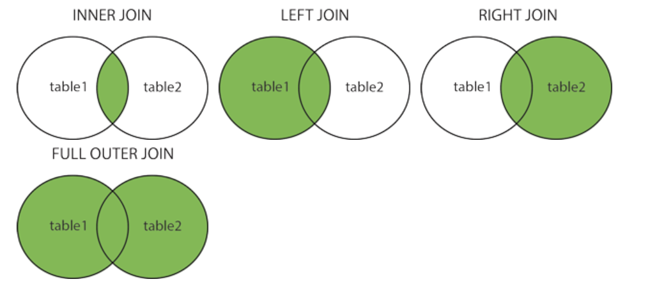
Different Types of SQL JOINs
Here are the different types of the JOINs in SQL:
(INNER) JOIN: Returns records that have matching values in both tables
LEFT (OUTER) JOIN: Returns all records from the left table, and the matched records from the right table
RIGHT (OUTER) JOIN: Returns all records from the right table, and the matched records from the left table
FULL (OUTER) JOIN: Returns all records when there is a match in either left or right table

Slide 4
Sample Tables
TableA
TableB
PK | Value
1 | FOX
2 | COP
3 | TAXI
6 | WASHINGTON
7 | DELL
5 | ARIZONA
4 | LINCOLN
10 | LUCENT
PK | Value
1 | TROT
2 | CAR
3 | CAB
6 | MONUMENT
7 | PC
8 | MICROSOFT
9 | APPLE
11 | SCOTCH

Slide 5
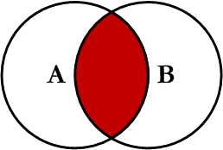
Inner Join
Inner join produces only the set of records that match in both Table A and Table B
Most commonly used, best understood join
Note:
Inner Joins do not have to use equality to join the fields
Can use <, >, <>
INNER JOIN Syntax
SELECT column_name(s) FROM table1 INNER JOIN table2 ON table1.column_name = table2.column_name;

Slide 6
Inner Join
TableA Value | PK | TableB PK | Value
FOX | 1 | 1 | TROT
COP | 2 | 2 | CAR
TAXI | 3 | 3 | CAB
WASHINGTON | 6 | 6 | MONUMENT
DELL | 7 | 7 | PC
SELECT *
FROM TableA INNER JOIN TableB
ON TableA.PK = TableB.PK;
This is the same as doing
SELECT *
FROM TableA, TableB
WHERE TableA.PK = TableB.PK;

Slide 7
Inner Join (continued)
TableA PK | Value | TableB PK | Value
2 | COP | 1 | TROT
3 | TAXI | 1 | TROT
3 | TAXI | 2 | CAR
4 | LINCOLN | 1 | TROT
4 | LINCOLN | 2 | CAR
4 | LINCOLN | 3 | CAB
5 | ARIZONA | 1 | TROT
5 | ARIZONA | 2 | CAR
5 | ARIZONA | 3 | CAB
… | More… | Rows…
SELECT *
FROM TableA
INNER JOIN TableB
ON TableA.PK > TableB.PK;

Slide 8
Example of Inner Join
Retrieve the list of employees along with the names of the departments they belong to.
SELECT
E.Fname,
E.Lname,
D.Dname
FROM
EMPLOYEE E
INNER JOIN
DEPARTMENT D
ON
E.Dno = D.Dnumber;
The INNER JOIN combines rows from the EMPLOYEE and DEPARTMENT tables where the Dno column in EMPLOYEE matches the Dnumber column in DEPARTMENT.

Slide 9
Example of Natural Join
Retrieve the list of projects along with their corresponding department locations.
SELECT
P.Pname,
DL.Dlocation
FROM
PROJECT P
NATURAL JOIN
DEPT_LOCATION DL;
The NATURAL JOIN automatically matches columns with the same name and compatible data types, which in this case are Dnumber in PROJECT and DEPT_LOCATION.
This query retrieves project names and their corresponding department locations without explicitly specifying the join condition.

Slide 10
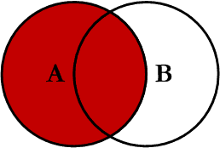
Left Outer Join
Left outer join produces a complete set of records from Table A, with the matching records (where available) in Table B. If there is no match, the right side will contain null.

Slide 11
Left Outer Join
TableA Value | PK | TableB PK | Value
FOX | 1 | 1 | TROT
COP | 2 | 2 | CAR
TAXI | 3 | 3 | CAB
LINCOLN | 4 | NULL | NULL
ARIZONA | 5 | NULL | NULL
WASHINGTON | 6 | 6 | MONUMENT
DELL | 7 | 7 | PC
LUCENT | 10 | NULL | NULL
SELECT *
FROM TableA LEFT OUTER JOIN TableB
ON TableA.PK = TableB.PK

Slide 12
SQL Joins…Example
SELECT S.name, E.classid
FROM Students S LEFT OUTER JOIN Enrolled E
ON S.sid=E.sid
S
S.name | S.sid
Jones | 11111
Smith | 22222
Brown | 33333
E
E.sid | E.classid
11111 | History105
11111 | DataScience194
22222 | French150
44444 | English10
S.name | E.classid
Jones | History105
Jones | DataScience194
Smith | French150
Brown | NULL
Notes:
Missing (unmatched) key values

Slide 13
Example of Left Outer Join
A Left Outer Join retrieves all rows from the DEPARTMENT table, along with matching rows from the EMPLOYEE table based on the Mgr_ssn column in DEPARTMENT and the Ssn column in EMPLOYEE.
If a department does not have a manager assigned (i.e., Mgr_ssn is NULL), the query will still include the department, but the manager's name will show as NULL.
SELECT
D.Dname,
E.Fname,
E.Lname
FROM
DEPARTMENT D
LEFT OUTER JOIN
EMPLOYEE E
ON
D.Mgr_ssn = E.Ssn;

Slide 14
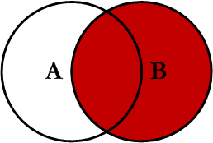
Right Outer Join
Right outer join produces a complete set of records from Table B, with the matching records (where available) in Table A. If there is no match, the left side will contain null.

Slide 15
Right Outer Join
Note: RIGHT are not currently supported
TableA Value | PK | TableB PK | Value
FOX | 1 | 1 | TROT
COP | 2 | 2 | CAR
TAXI | 3 | 3 | CAB
WASHINGTON | 6 | 6 | MONUMENT
DELL | 7 | 7 | PC
NULL | NULL | 8 | MICROSOFT
NULL | NULL | 9 | APPLE
NULL | NULL | 11 | SCOTCH
SELECT *
FROM TableA RIGHT OUTER JOIN TableB
ON TableA.PK = TableB.PK

Slide 16
SQL Joins…..example
SELECT S.name, E.classid
FROM Students S RIGHT OUTER JOIN Enrolled E
ON S.sid=E.sid
S
S.name | S.sid
Jones | 11111
Smith | 22222
Brown | 33333
E
E.sid | E.classid
11111 | History105
11111 | DataScience194
22222 | French150
44444 | English10
S.name | E.classid
Jones | History105
Jones | DataScience194
Smith | French150
NULL | English10
Notes:
Missing (unmatched) key values

Slide 17
Example of Right Outer Join
A Right Outer Join retrieves all rows from the DEPARTMENT table, along with matching rows from the EMPLOYEE table based on the Dno column in EMPLOYEE and the Dnumber column in DEPARTMENT.
If a department does not have any employees, the department will still be included, but the employee fields will show as NULL.
SELECT
E.Fname AS EmployeeFirstName,
E.Lname AS EmployeeLastName,
D.Dname AS DepartmentName
FROM
EMPLOYEE E
RIGHT OUTER JOIN
DEPARTMENT D
ON
E.Dno = D.Dnumber;

Slide 18
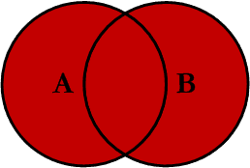
Full Outer Join
Full outer join produces the set of all records in Table A and Table B, with matching records from both sides where available. If there is no match, the missing side will contain null.

Slide 19
Full Outer Join
TableA Value | PK | TableB PK | Value
FOX | 1 | 1 | TROT
COP | 2 | 2 | CAR
TAXI | 3 | 3 | CAB
LINCOLN | 4 | NULL | NULL
ARIZONA | 5 | NULL | NULL
WASHINGTON | 6 | 6 | MONUMENT
DELL | 7 | 7 | PC
LUCENT | 10 | NULL | NULL
NULL | NULL | 8 | MICROSOFT
NULL | NULL | 9 | APPLE
NULL | NULL | 11 | SCOTCH
SELECT * FROM TableA FULL OUTER JOIN TableB ON TableA.PK
= TableB.PK

Slide 20
SQL Joins….. Example
Note: FULL are not currently supported
SELECT S.name, E.classid
FROM Students S FULL OUTER JOIN Enrolled E
ON S.sid=E.sid
S
S.name | S.sid
Jones | 11111
Smith | 22222
Brown | 33333
E
E.sid | E.classid
11111 | History105
11111 | DataScience194
22222 | French150
44444 | English10
S.name | E.classid
Jones | History105
Jones | DataScience194
Smith | French150
NULL | English10
Brown | NULL
Notes:
Missing (unmatched) key values

Slide 21
Example Full Outer Join
A Full Outer Join retrieves all rows from both the EMPLOYEE and DEPARTMENT tables.
Rows from EMPLOYEE that do not have a matching department will show NULL in the department fields.
Rows from DEPARTMENT without employees will show NULL in the employee fields.
SELECT
E.Fname,
E.Lname,
D.Dname
FROM
EMPLOYEE E
FULL OUTER JOIN
DEPARTMENT D
ON
E.Dno = D.Dnumber;

Slide 22
Cross Join
A cross join is a Cartesian Product join – it is every record in Table A combined with every record in Table B.
It gives the same results as not using a WHERE clause when querying two tables in MySQL
SELECT * from TableA CROSS JOIN TableB
SELECT * from TableA, TableB

Slide 23
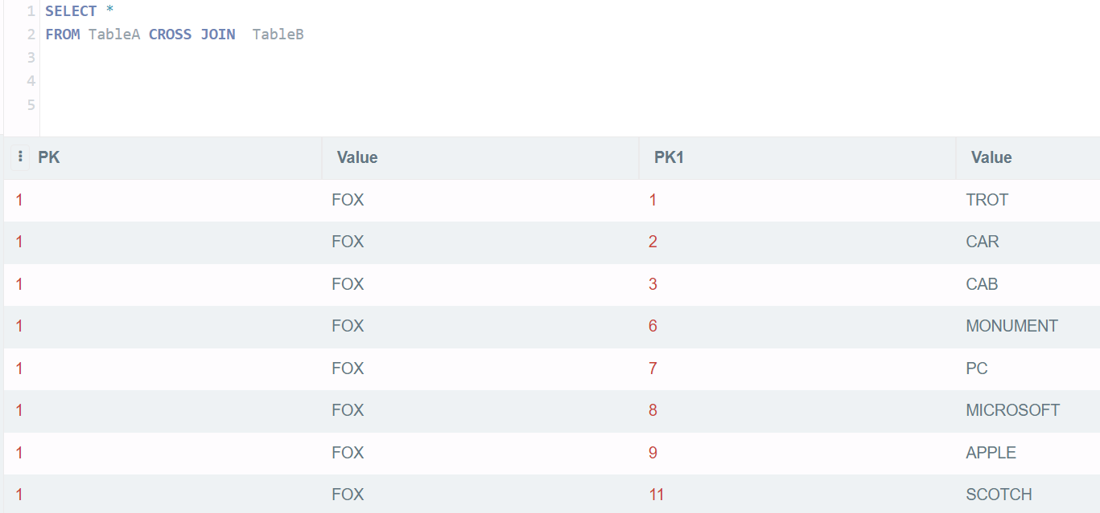
Cross Join

Slide 24
SQL Joins
SELECT *
FROM Students S CROSS JOIN Enrolled E
S
S.name | S.sid
Jones | 11111
Smith | 22222
E
E.sid | E.classid
11111 | History105
11111 | DataScience194
22222 | French150
S.name | S.sid | E.sid | E.classid
Jones | 11111 | 11111 | History105
Jones | 11111 | 11111 | DataScience194
Jones | 11111 | 22222 | French150
Smith | 22222 | 11111 | History105
Smith | 22222 | 11111 | DataScience194
Smith | 22222 | 22222 | French150

Slide 25
Example of Cross Join
SELECT
E.Fname,
E.Lname,
P.Pname
FROM
EMPLOYEE E
CROSS JOIN
PROJECT P;
A Cross Join returns the Cartesian product of two tables, which means every row from the first table is combined with every row from the second table.
Every row from the EMPLOYEE table is paired with every row from the PROJECT table.

Slide 26
Theta Joins
SELECT *
FROM Students S, Enrolled E
WHERE S.sid <= E.sid
S
S.name | S.sid
Jones | 11111
Smith | 22222
E
E.sid | E.classid
11111 | History105
11111 | DataScience194
22222 | French150
S.name | S.sid | E.sid | E.classid
Jones | 11111 | 11111 | History105
Jones | 11111 | 11111 | DataScience194
Jones | 11111 | 22222 | French150
Smith | 22222 | 22222 | French150

Slide 27
Theta Join
A Theta Join is a type of join where the condition involves a comparison operator other than equality (=). This includes operators like <, >, <=, >=, or !=.
SELECT
E1.Fname,
E1.Lname,
E1.Salary,
E2.Fname AS 'Colleague Name',
E2.Lname AS 'Colleague Last Name',
E2.Salary AS 'Colleague Salary'
FROM
EMPLOYEE E1
JOIN
EMPLOYEE E2
ON
E1.Dno = E2.Dno AND E1.Salary > E2.Salary;
Find all employees whose salary is greater than the salary of employees in the same department.
This query performs a theta join between the EMPLOYEE table and itself, but with two aliases (E1 and E2).The join condition checks:
E1.Dno = E2.Dno:
Employees must be in the same department.
E1.Salary > E2.Salary:
Employee E1's salary must be greater than Employee E2's salary.

Slide 28
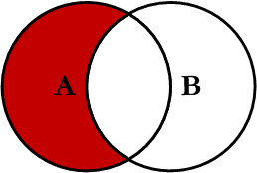
Left Join Excluding Inner Join
This query will return all of the records in the left table (table A) that do not match any records in the right table (table B).

Slide 29
Left Join Excluding Inner Join
TableA Value | PK | TableB PK | Value
LINCOLN | 4 | NULL | NULL
ARIZONA | 5 | NULL | NULL
LUCENT | 10 | NULL | NULL
SELECT * FROM TableA LEFT JOIN TableB
ON TableA.PK = TableB.PK
WHERE TableB.PK IS NULL;
Perform left outer join, then exclude the records we don't want from the right side via a where clause.

Slide 30
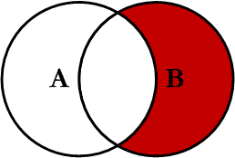
Right Join Excluding Inner Join
This query will return all of the records in the right table (table B) that do not match any records in the left table (table A).

Slide 31
Right Join Excluding Inner Join
TableA Value | PK | TableB PK | Value
NULL | NULL | 8 | MICROSOFT
NULL | NULL | 9 | APPLE
NULL | NULL | 11 | SCOTCH
SELECT * FROM TableA RIGHT JOIN TableB
ON TableA.PK = TableB.PK
WHERE TableA.PK IS NULL
Perform right outer join, then exclude the records we don't want from the left side via a where clause.

Slide 32
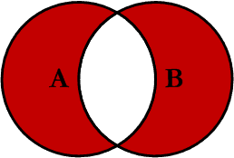
Full Outer Excluding Inner Join
This query will return all of the records in Table A and Table B that do not have a matching record in the other table.
In general, Not used

Slide 33
Full Outer Excluding Inner Join
TableA Value | PK | TableB PK | Value
NULL | NULL | 8 | MICROSOFT
NULL | NULL | 9 | APPLE
NULL | NULL | 11 | SCOTCH
LINCOLN | 4 | NULL | NULL
ARIZONA | 5 | NULL | NULL
LUCENT | 10 | NULL | NULL
SELECT * FROM TableA FULL OUTER JOIN TableB
ON TableA.PK = TableB.PK
WHERE TableA.PK IS NULL OR TableB.PK IS NULL

